Slide 1

Batch Normalization
Fitting Batch Norm
into a neural network
deeplearning.ai

Slide 2




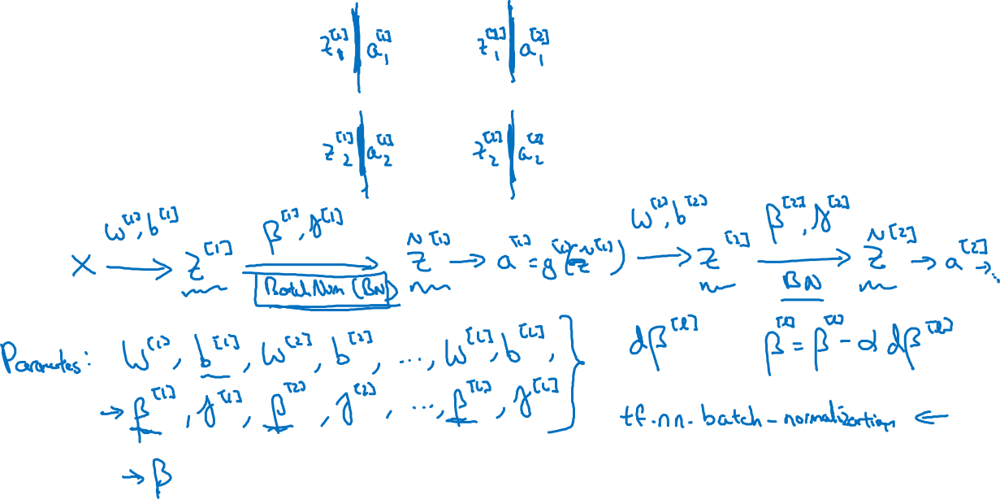
Adding Batch Norm to a network
$$x_{1}$$
$$x_{2}$$
$$\hat{y}$$
$$x_{3}$$

Slide 3
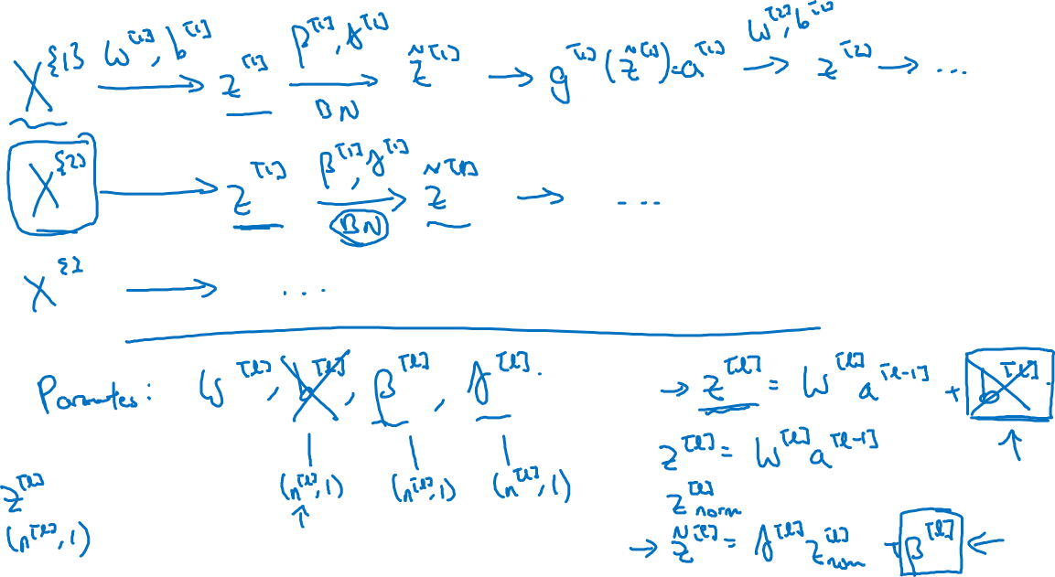
Working with mini-batches

Slide 4
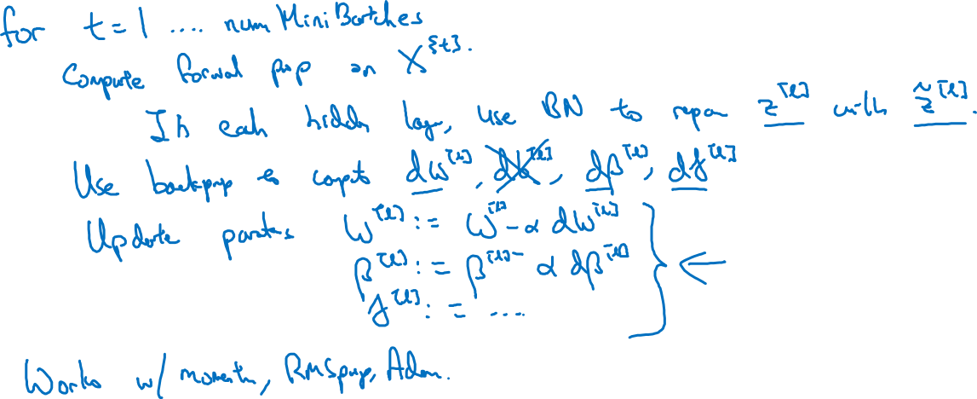
Implementing gradient descent

